Slide 1



Build your applications with cognitive APIs
The power of API aggregation
Sandra Calvo
Hybrid Cloud
IBM Finland

Slide 2





Cognitive APIs

Slide 3













Combine Cognitive APIs

Slide 4


Decision making process
Observe
Interpretet
Evaluate
Decide
How do I get started?

Slide 5













IBM Bluemix
Bluemix is an open-standard, cloud-based platform for building, managing, and running applications.
Go Live in Seconds
APIs and Services
On-prem integration
DevOps
Layered Security
Flexible Pricing

Slide 6
























How does Bluemix work?
DevOps
Tooling
Integration and API Management
Your Own Hosted Apps / Services
Catalog of Services that Extend Apps’ Functionality
+
Web
Data
Mobile
Cognitive
Analytics
IoT
Security
Yours
Flexible Compute Options to Run Apps / Services
Instant Runtimes
+
Containers
+
Virtual Machines
+
Platform Deployment Options that Meet Your Workload Requirements
+
Bluemix
Public
Bluemix
Dedicated
Bluemix
Local
+
Powered by IBM SoftLayer
In Your Data Center

Slide 7



Bluemix capabilities
Reinvent processes across the API economy
Embrace agile to accelerate transformation
Optimize decisions with cognitive insight
Deliver adaptive personalized experiences
No hardware investment
Flexibility
Availability
Security
Pay-per-use
Scalability

Slide 8
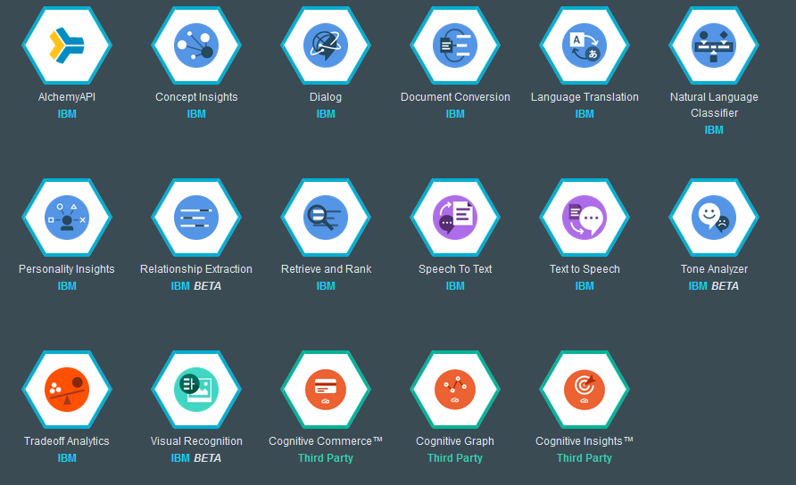
Bluemix - Cognitive capabilities
Watson Services

Slide 9













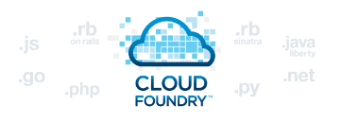
Traditional IT, IaaS, PaaS
Customer Managed
Service Provider Managed
Traditional IT
Infrastructure as a Service
Platform as a Service
Code
Code
Code
Data
Data
Data
Runtime
Runtime
Runtime
Middleware
Middleware
Middleware
OS
OS
OS
Virtualization
Virtualization
Virtualization
Servers
Servers
Servers
Storage
Storage
Storage
Networking
Networking
Networking
Time to deployment
~ Weeks
~ Days
~ Minutes

Slide 10
Pizza as a Service
Traditional IT
Infrastructure as a Service
Platform as a Service
Software as a Service
Dining table
Dining table
Dining table
Dining table
Bake in oven
Bake in oven
Bake in oven
Bake in oven
Bake Pizza
Bake Pizza
Bake Pizza
Bake Pizza
Ingredients
Ingredients
Ingredients
Ingredients
Dough
Dough
Dough
Dough
Gas
Gas
Gas
Gas
Electricity
Electricity
Electricity
Electricity
Baking Dishes
Baking Dishes
Baking Dishes
Baking Dishes
Oven
Oven
Oven
Oven

Slide 11






























What are customers doing with Bluemix?
Startups
&
Enterprises

Slide 12
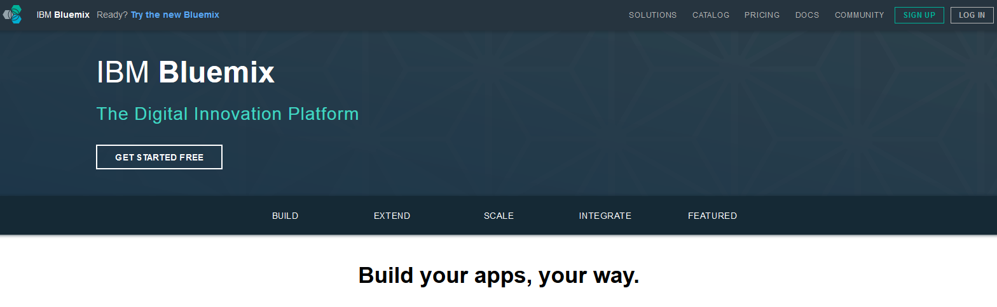
What can YOU do with Bluemix?
https://bluemix.net/

Slide 13
Bluemix Garage
”We co-design and develop amazing things with you.”
Design
Scale
Train
Notes:
We help our clients, small and large, to quickly transform their business to take full advantage of the Cloud
we rapidly identify, design, prove, and build the right innovative, scalable applications for the client’s target market on IBM Bluemix
we build modern Hybrid Cloud platforms to scale with client’s needs
we enable and train client’s teams to rapidly adopt Cloud solutions
We take a Lean and User Centered Design approach to help you rapidly Identify, Prove, Design, Build and Deploy the right app for the target market. With IBM Design Thinking we Define The Right Product with the right Experience.

Slide 14
Bluemix Garage culture
Think
Learn
Code
Culture
Manage
Deliver
Run
Notes:
Think: Conceptualization, refinement, and prioritization of capabilities
Code: Generation, enhancement, optimization and testing of features
Deliver: Automated production and delivery of offerings
Run: Services, options, and capabilities required to run In the Cloud
Manage: Ongoing Monitoring, Support, and Recovery of offerings
Learn: Continuously learn based on outcomes from experiments
Culture: Foundational values and principles
Applied by our global team of:
Visual and UX Designers
Solution Architects
Developers
Mobile SMEs
DevOps SMEs
Integration Experts
’

Slide 15
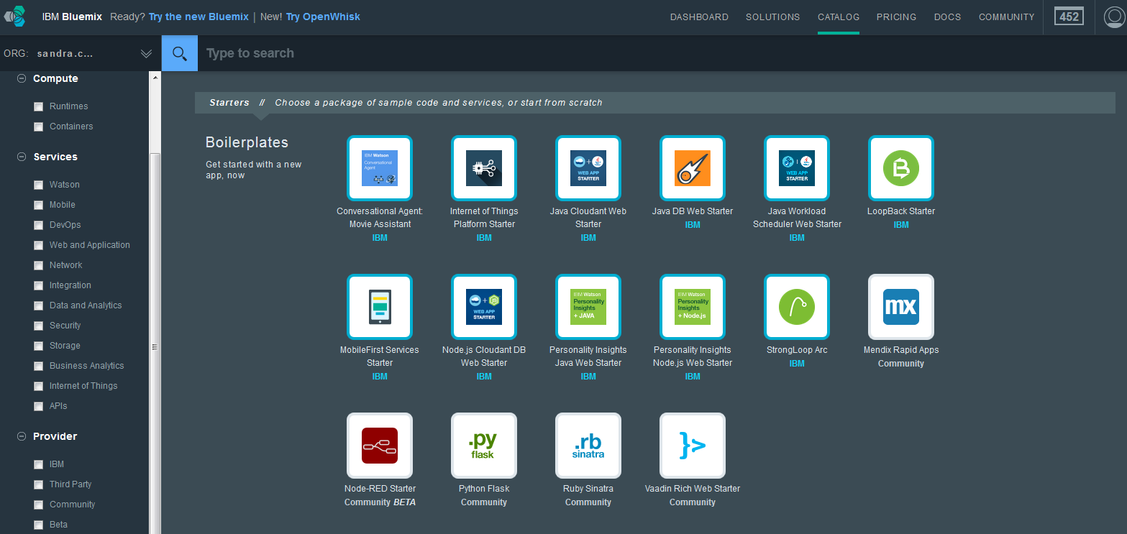
Let’s take a quick look at Bluemix

Slide 16
Thank you

Slide 17
Bluemix is built on IBM Softlayer
A different kind of data center
Every location designed, built, and operated to the same standardized, “pod” based spec
24/7 on-site security and rigorous controls
Expanding to 40 data centers worldwide
Global network of networks
Public, private, and management networks all separate
More than 2,000Gbps between data centers and network points of presence (PoPs)
Unmetered inbound public bandwidth and fully unmetered bandwidth between data centers
Entirely automated
SoftLayer API controls everything - more than 3000 documented methods and 180 distinct services
Bare metal and virtualized servers in the same platform
London
Dallas
Sydney
IBM Bluemix and SoftLayer provide a complete solution that that will protect critical web apps, data, and processes throughout their lifecycle.

